Slide 1
Roots

Slide 2
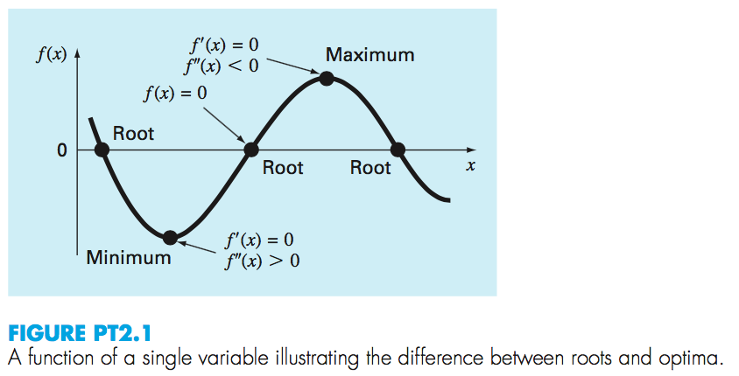

Slide 3
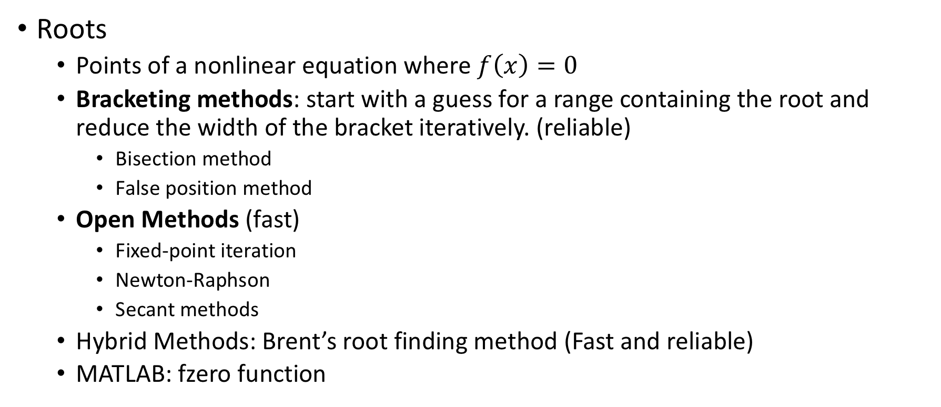
Overview
Roots
  Points of a nonlinear equation where $f\left(x\right)=0$
  Bracketing methods: start with a guess for a range containing the root and reduce the width of the bracket iteratively. (reliable)
    Bisection method
    False position method
  Open Methods (fast)
    Fixed-point iteration
    Newton-Raphson
    Secant methods
  Hybrid Methods: Brent’s root finding method (Fast and reliable)
  MATLAB: fzero function

Slide 4
Overview
Optimization
  Bracketing methods:
    Golden-section search
    Parabolic interpolation
  Hybrid approach: combine golden-section and quadratic interpolation
  MATLAB: fminbnd
  Multidimensional optimization
    MATLAB: fminsearch

Slide 5

Motivation
How to Solve?

Slide 6
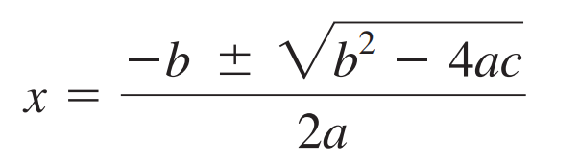
Motivation
How to Solve?

Slide 7
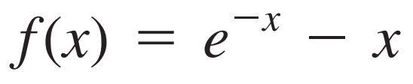
Motivation
How to Solve? Find x that makes the function f(x) zero (find root).

Slide 8
Motivation
How to Solve? Find x that makes the function f(x) zero (find root).
Cannot be solved analytically.

Slide 9
Motivation
How to Solve? Find x that makes the function f(x) zero (find root).
Cannot be solved analytically.

Slide 10
Motivation
How to Solve? Find x that makes the function f(x) zero (find root).
Cannot be solved analytically.
One method to obtain an approximate solution is to plot the function and determine where it crosses the x axis.

Slide 11
Motivation
How to Solve? Find x that makes the function f(x) zero (find root).
Cannot be solved analytically.
One method to obtain an approximate solution is to plot the function and determine where it crosses the x axis.

Slide 12
Motivation
How to Solve? Find x that makes the function f(x) zero (find root).
Cannot be solved analytically.
One method to obtain an approximate solution is to plot the function and determine where it crosses the x axis.
Although graphical methods are useful for obtaining rough estimates of roots, they are limited because of their lack of precision.

Slide 13
Motivation
How to Solve? Find x that makes the function f(x) zero (find root).
Cannot be solved analytically.
An alternative approach is to use trial and error.
This “technique” consists of guessing a value of x and evaluating whether f(x) is zero.

Slide 14
Motivation
How to Solve? Find x that makes the function f(x) zero (find root).
Cannot be solved analytically.
An alternative approach is to use trial and error.
This “technique” consists of guessing a value of x and evaluating whether f(x) is zero.
If not (as is almost always the case), another guess is made, and f(x) is again evaluated to determine whether the new value provides a better estimate of the root. The process is repeated until a guess is obtained that results in an f(x) that is close to zero.

Slide 15
Motivation
How to Solve? Find x that makes the function f(x) zero (find root).
Cannot be solved analytically.
An alternative approach is to use trial and error.
This “technique” consists of guessing a value of x and evaluating whether f(x) is zero.
If not (as is almost always the case), another guess is made, and f(x) is again evaluated to determine whether the new value provides a better estimate of the root. The process is repeated until a guess is obtained that results in an f(x) that is close to zero.
Such methods may be inadequate!

Slide 16
Motivation
How to Solve? Find x that makes the function f(x) zero (find root).
Cannot be solved analytically.
An alternative approach is to use trial and error.
This “technique” consists of guessing a value of x and evaluating whether f(x) is zero.
If not (as is almost always the case), another guess is made, and f(x) is again evaluated to determine whether the new value provides a better estimate of the root. The process is repeated until a guess is obtained that results in an f(x) that is close to zero.
Such methods may be inadequate!
Thus, we will learn systematic approaches to approximate true value of root.

Slide 17
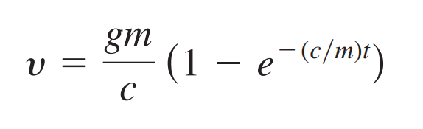
Motivation
where velocity v the dependent variable, time t the independent variable, the gravitational constant g the forcing function, and the drag coefficient c and mass m parameters.

Slide 18
Motivation
where velocity v the dependent variable, time t the independent variable, the gravitational constant g the forcing function, and the drag coefficient c and mass m parameters.
it cannot be solved explicitly for the drag coefficient.
There is no way to rearrange the equation so that c is isolated on one side of the equal sign.

Slide 19
Motivation
where velocity v the dependent variable, time t the independent variable, the gravitational constant g the forcing function, and the drag coefficient c and mass m parameters.
it cannot be solved explicitly for the drag coefficient.
There is no way to rearrange the equation so that c is isolated on one side of the equal sign.
In such cases, c is said to be implicit.

Slide 20
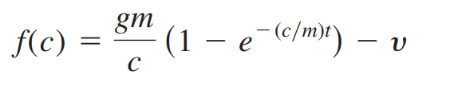
Motivation
To solve the problem using numerical methods, it is conventional to reexpress Eq above.
The value of c that makes f(c) 0 is, therefore, the root of the equation.

Slide 21


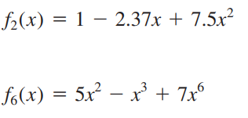
Mathematical Bckground.
By definition, a function given by y = f(x) is algebraic if it can be expressed in the form:
Polynomials are a simple class of algebraic functions that are represented generally by
Some examples:

Slide 22
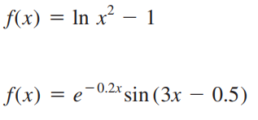
Mathematical Bckground.
A transcendental function is one that is nonalgebraic. These include trigonometric,exponential, logarithmic, and other, less familiar, functions.
Some examples:

Slide 23
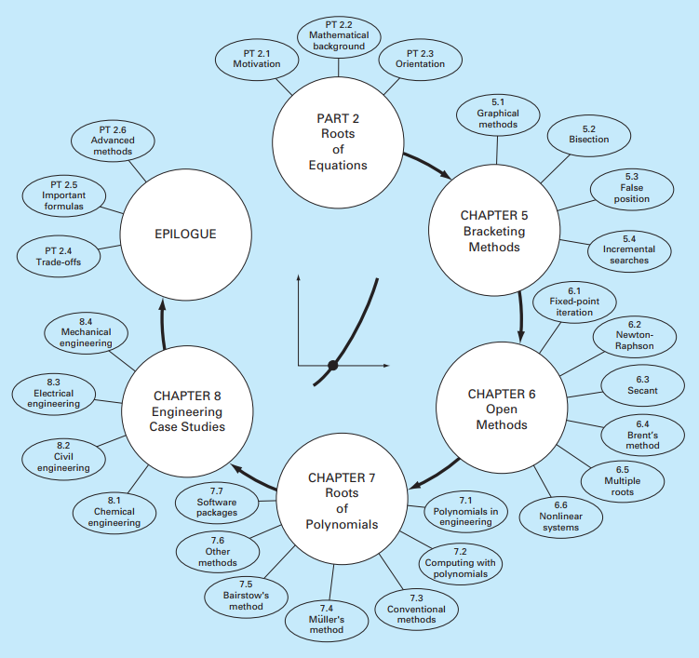
Orientation.

Slide 24
Roots: Bracketing Methods

Slide 25
Chapter Objectives
Understanding what roots problems are and where they occur in engineering and science.
Knowing how to determine a root graphically.
Understanding the incremental search method and its shortcomings.
Knowing how to solve a roots problem with the bisection method.
Knowing how to estimate the error of bisection and why it differs from error estimates for other types of root location algorithms.
Understanding false position and how it differs from bisection.

Slide 26
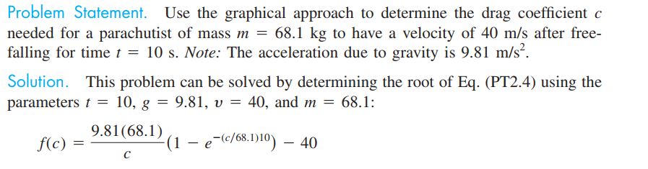

Graphical Methods
or

Slide 27
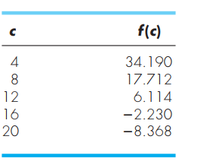
Graphical Methods
or

Slide 28
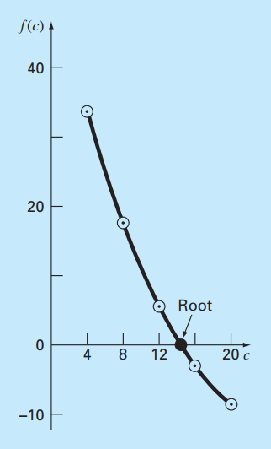
Graphical Methods
or

Slide 29
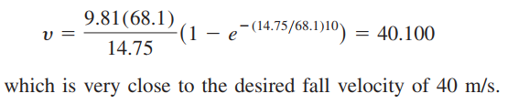
Graphical Methods
Visual inspection of the plot provides a rough
estimate of the root of 14.75.

Slide 30
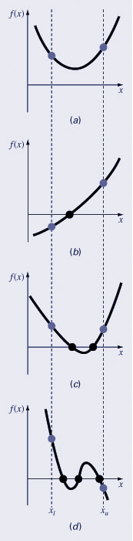
Graphical Methods
A simple method for obtaining the estimate of the root of the equation f(x)=0 is to make a plot of the function and observe where it crosses the x-axis.
Graphing the function can also indicate where roots may be and where some root-finding methods may fail:
  Same sign, no roots
  Different sign, one root
  Same sign, two roots (even number of roots)
  Different sign, three roots (odd number of roots)

Slide 31
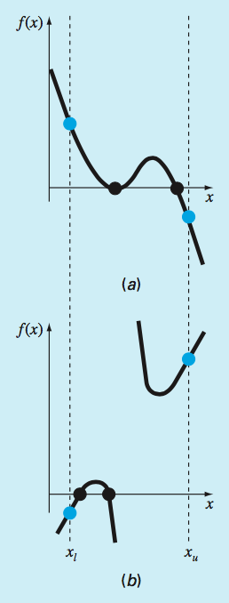
Exceptions

Slide 32
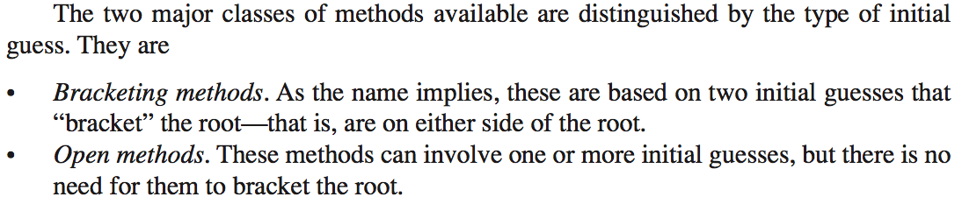

Slide 33
Roots
Bracketing Methods:
  Always work
  Converge slowly
Open Methods
  Do not always work (can diverge)
  Converge quicker

Slide 34
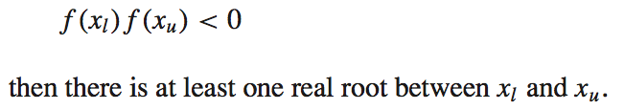
Incremental search
Approach to obtain initial guesses
The incremental search method tests the value of the function at evenly spaced intervals and finds brackets by identifying function sign changes between neighboring points.
If

Slide 35
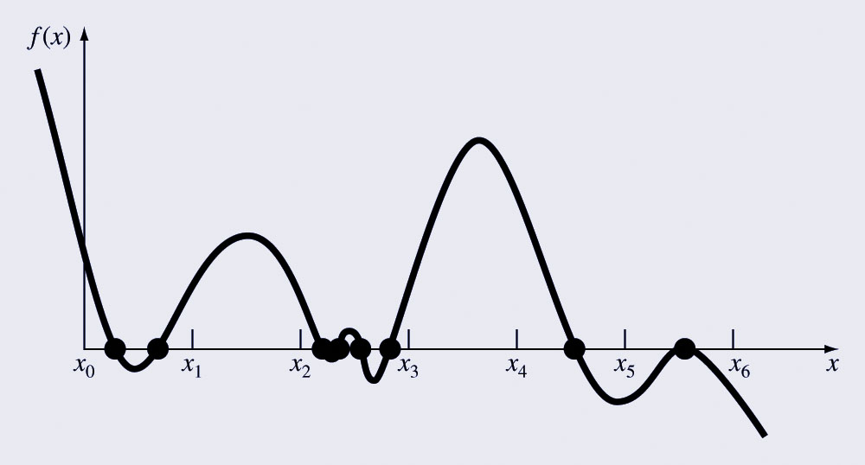
Incremental Search Hazards
If the spacing between the points of an incremental search are too far apart, brackets may be missed due to capturing an even number of roots within two points.
Incremental searches cannot find brackets containing even-multiplicity roots regardless of spacing.

Slide 36
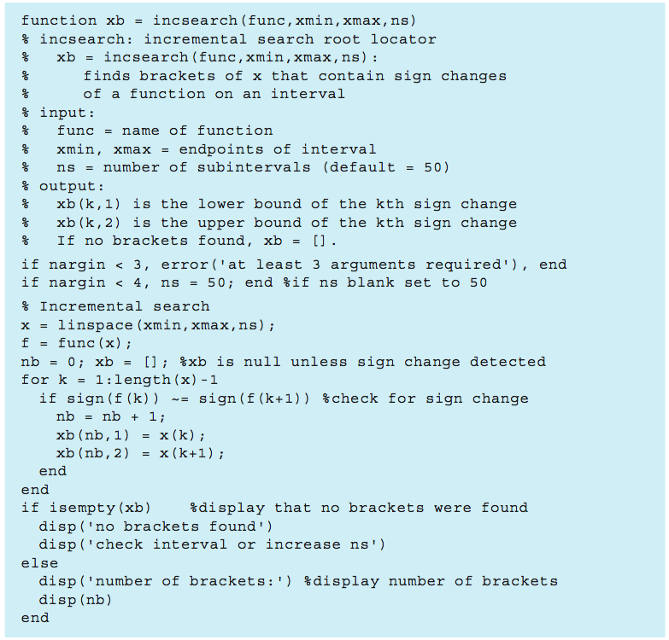

Slide 37

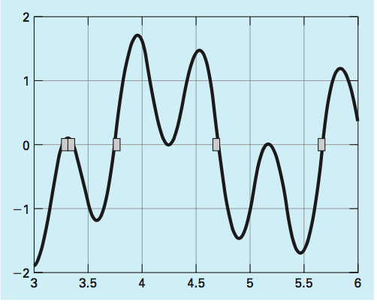
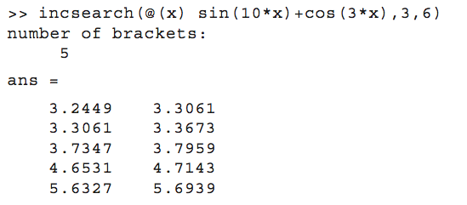
Example

Slide 38
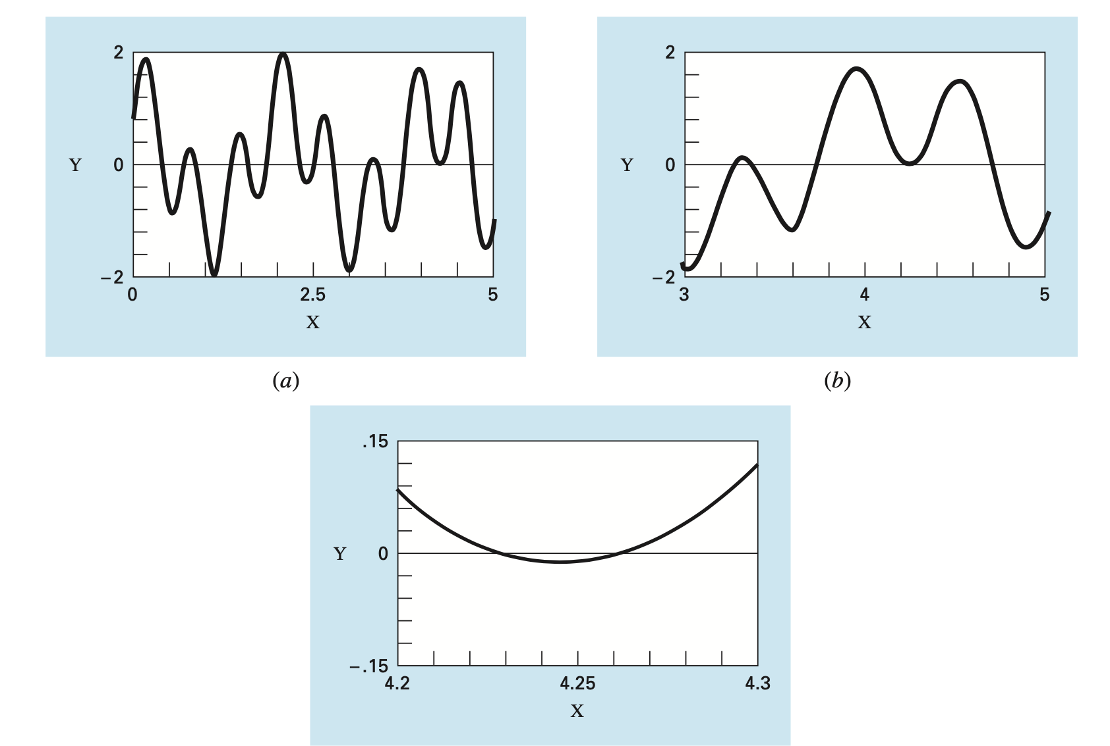

Slide 39
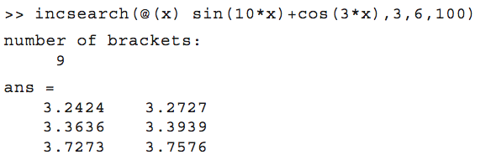
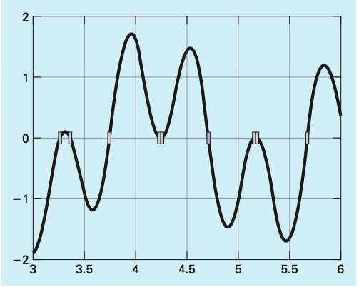
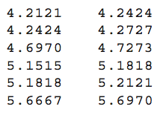
Example
Run with more subintervals

Slide 40
Bisection Method

Slide 41
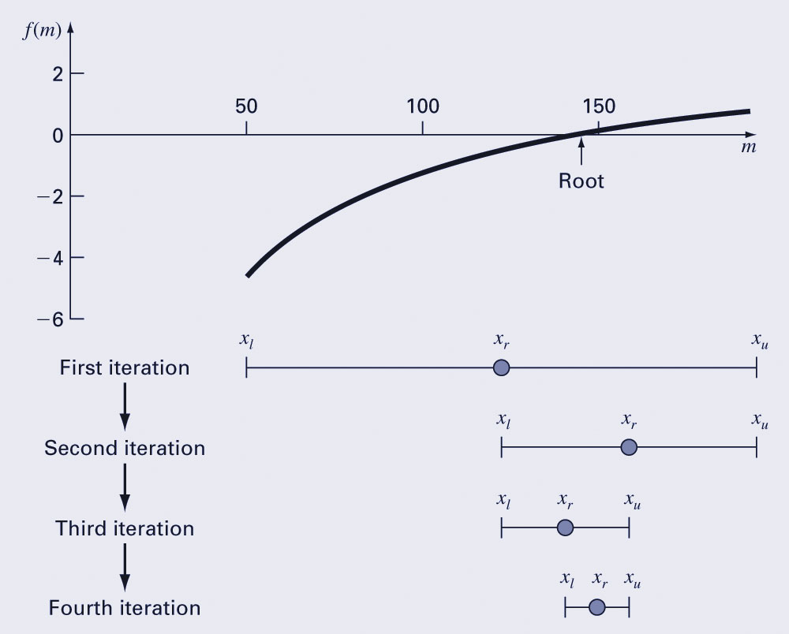





Bisection Method
The bisection method is a variation of the incremental search method in which the interval is always divided in half.
If a function changes sign over an interval, the function value at the midpoint is evaluated.
The location of the root is then determined as lying within the subinterval where the sign change occurs.
The absolute error is reduced by a factor of 2 for each iteration.

Slide 42



Bisection Method

Slide 43

Bisection Method
Iterate until the result is accurate enough.
We need an error estimate that does not require the knowledge of the true root.
Stop when the approximate relative percent error is below some value eps.
Approximate relative percent error:

Slide 44
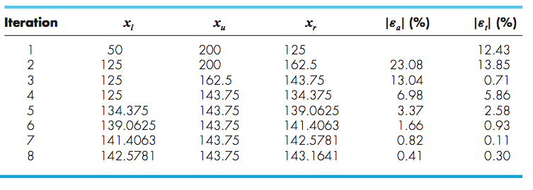
Bisection Method

Slide 45
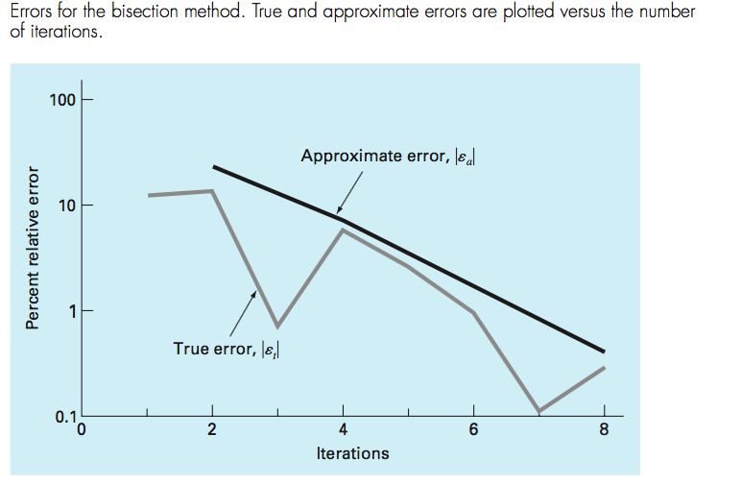

Bisection Method

Slide 46




Bisection Method
The number of iterations required to attain an absolute error can be computed a priori (before starting the iterations).
Before starting the absolute error is less than:
After the first iteration the error is less than:
Since each iteration halves the error, a general formula relating the error and the number of iterations is:

Slide 47
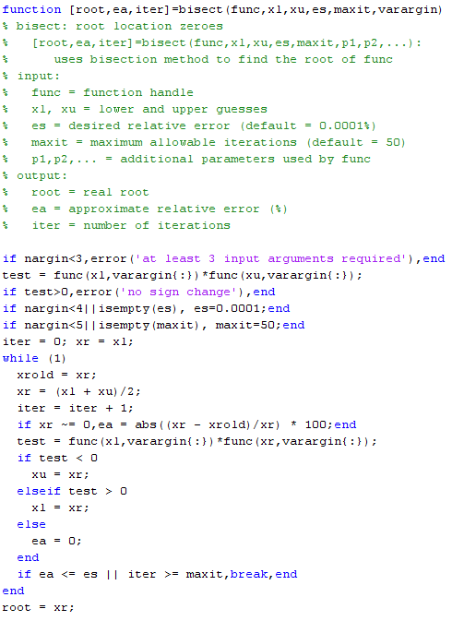


Slide 48

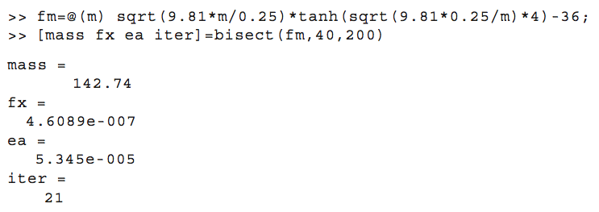
Bisection Method
Find the root of

Slide 49
False Position Method

Slide 50
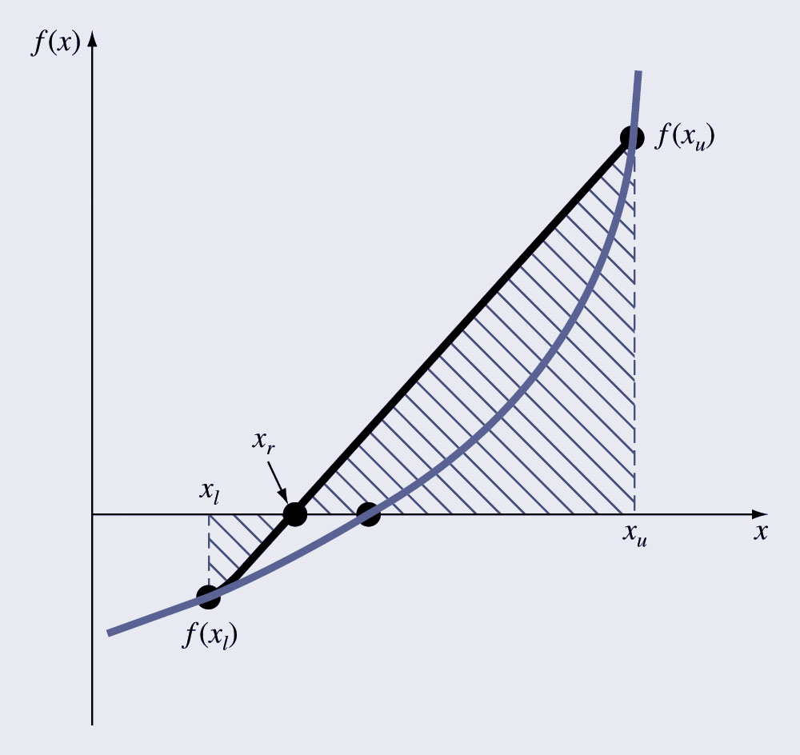
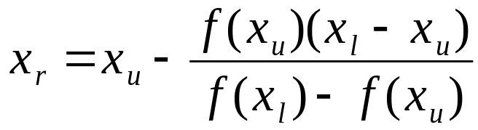
False Position Method
The false position method is another bracketing method.
It determines the next guess not by splitting the bracket in half but by connecting the endpoints with a straight line and determining the location of the intercept of the straight line (x_{r}).
The value of x_{r} then replaces whichever of the two initial guesses yields a function value with the same sign as f(x_{r}).
False position formula

Slide 51
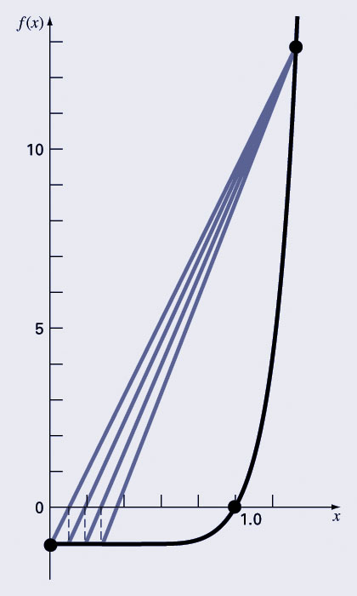

Bisection vs. False Position
Bisection does not take into account the shape of the function; this can be good or bad depending on the function!
Slow convergence:

Slide 52
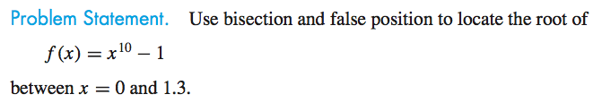
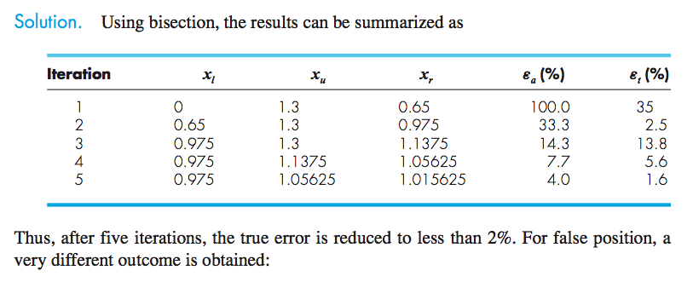
Example

Slide 53
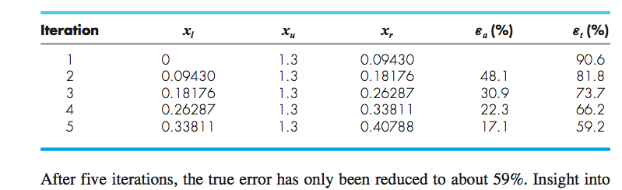
Example
This function violates the assumption that if f(x_l) is much closer to zero than f(x_u), then the root should be
much closer to x_l than x_r.

Slide 54
Summary
Although false position is generally superior to bisection, there are cases where this is not true.
False position is one-sided: one of the bracketing points will stay fixed. This can lead to poor convergence.
The results should always be checked by substituting the root estimate into the original equation and confirming that the result is close to zero.

Slide 55
Overview
Roots
  Points of a nonlinear equation where $f\left(x\right)=0$
  Bracketing methods: start with a guess for a range containing the root and reduce the width of the bracket iteratively. (reliable)
    Bisection method
    False position method
  Open Methods (fast)
    Fixed-point iteration
    Newton-Raphson
    Secant methods
  Hybrid Methods: Brent’s root finding method (Fast and reliable)
  MATLAB: fzero function

